Slide 1
Algorithm Analysis
CS 3100 – Data Structures & Algorithms
Lecture materials adapted from:
Coursenotes
A Practical Introduction to
Data Structures and Algorithm Analysis
Second Edition
Clifford A. Shaffer
Department of Computer Science
Virginia Tech
Copyright © 2000, 2001

Slide 2
Algorithms and Problems
Algorithm: a method or a process followed to solve a problem.
  A recipe.
A problem is a mapping of input to output.
An algorithm takes the input to a problem (function) and transforms it to the output.
A problem can have many algorithms.
Algorithm Analysis

Slide 3
Algorithm Properties
An algorithm possesses the following properties:
  It must be correct.
  It must be composed of a series of concrete steps.
  There can be no ambiguity as to which step will be performed next.
  It must be composed of a finite number of steps.
  It must terminate.
A computer program is an instance, or concrete representation, for an algorithm in some programming language.
Algorithm Analysis
Notes:
“Correct” means computes the proper function.
“Concrete steps” are executable by the machine in question.
We frequently interchange use of “algorithm” and “program” though they are actually different concepts.

Slide 4
How fast is an algorithm?
To compare two sorting algorithms, should we talk about how fast the algorithms can sort 10 numbers, 100 numbers or 1000 numbers?
We need a way to talk about how fast the algorithm grows or scales with the input size.
  Input size is usually called n
    What is n for a factoring algorithm?
  An algorithm can take 100n steps, or 2n² steps, which one is better?
Algorithm Analysis

Slide 5
Running Time Examples (1)
Example 1: a = b;
This assignment takes constant time. No dependence on n. (What if it was
a = a * b?)
Example 2:
sum = 0;
for (i=1; i<=n; i++)
sum += n;
Algorithm Analysis
Notes:
Asymptotic analysis is defined for equations. We need to convert programs to equations to analyze them.
The traditional notation is Θ(1), not Θ(c).
Θ(n) even though the value of sum is n².

Slide 6
Running Time Examples (2)
Example 2:
sum = 0;
for (i=0; i<n; i++)
for (j=0; j<n; j++)
sum++;
Algorithm Analysis
Notes:
First statement is Θ(1). Double for loop is Σi = Θ(n²). Final for loop is Θ(n). Result: Θ(n²).

Slide 7
Running Time Examples (3)
Example 3:
sum2 = 0;
for (i=0; i<n; i++)
for (j=0; j<i; j++)
sum2++;
Algorithm Analysis
Notes:
First loop, sum is n². Second loop, sum is (n+1)(n)/2. Both are Θ(n²).

Slide 8
Running Time Examples (3)
Example 3:
sum2 = 0;
for (i=0; i<n; i++)
for (j=0; j<n; j++)
for (k=0; k<i; j++)
sum2++;
Algorithm Analysis
Notes:
First loop, sum is n². Second loop, sum is (n+1)(n)/2. Both are Θ(n²).

Slide 9
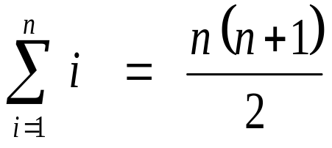
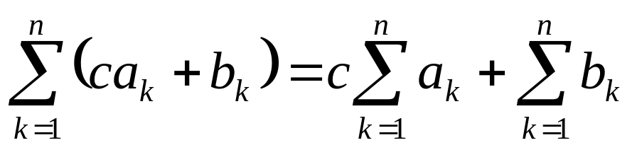
Series Sums
The arithmetic series:
  1 + 2 + 3 + … + n =
Linearity:
Algorithm Analysis

Slide 10
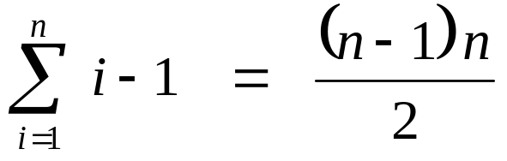
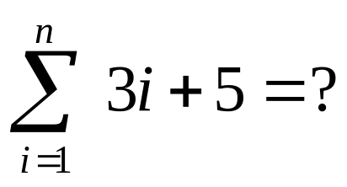
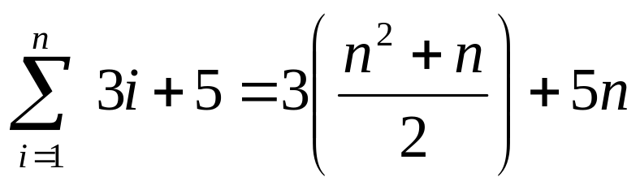
Series Sums
0 + 1 + 2 + … + n – 1 =
Example:
Algorithm Analysis

Slide 11
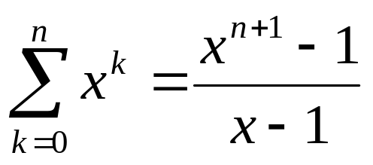
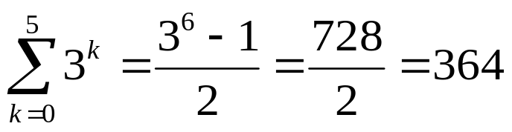
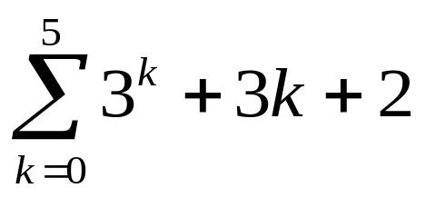
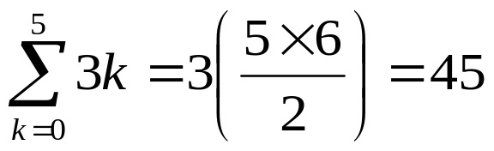
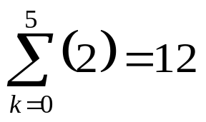

More Series
Geometric Series: 1 + x + x² + x³ + … + x^{n}
Example:
Algorithm Analysis

Slide 12
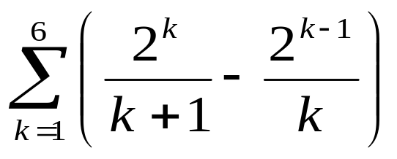
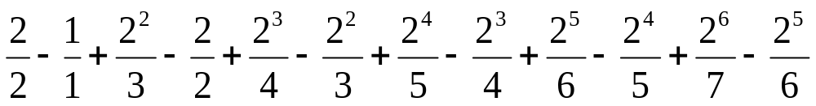
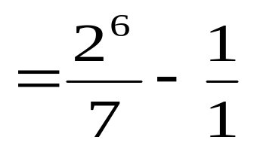
Telescoping Series
Consider the series:
Look at the terms:
Algorithm Analysis

Slide 13
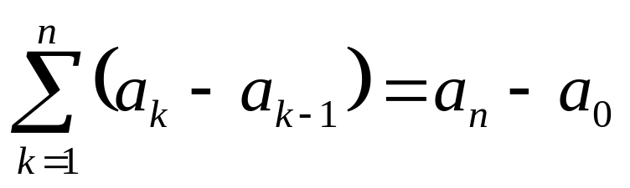
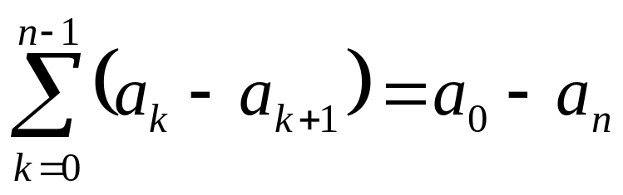
Telescoping Series
In general:
Algorithm Analysis

Slide 14
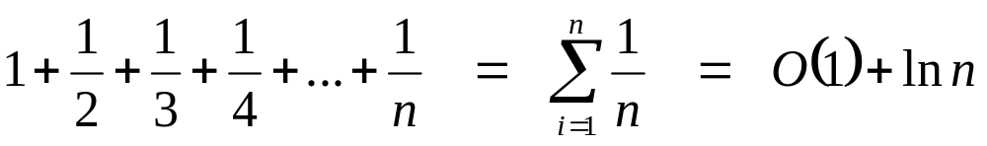
The Harmonic Series
Algorithm Analysis

Slide 15
Introduction to Asymptotic Notation
We want to express the concept of “about”, but in a mathematically rigorous way
Limits are useful in proofs and performance analyses
Θ notation: Θ(n²) = “this function grows similarly to n²”.
Big-O notation: O (n²) = “this function grows at least as slowly as n²”.
  Describes an upper bound.
Algorithm Analysis

Slide 16
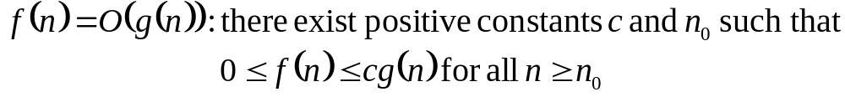
Big-O
What does it mean?
  If f(n) = O(n²), then:
    f(n) can be larger than n² sometimes, but…
    I can choose some constant c and some value n₀ such that for every value of n larger than n₀ : f(n) < cn²
    That is, for values larger than n₀, f(n) is never more than a constant multiplier greater than n²
    Or, in other words, f(n) does not grow more than a constant factor faster than n².
Algorithm Analysis

Slide 17
Visualization of O(g(n))
cg(n)
f(n)
n₀
Algorithm Analysis

Slide 18
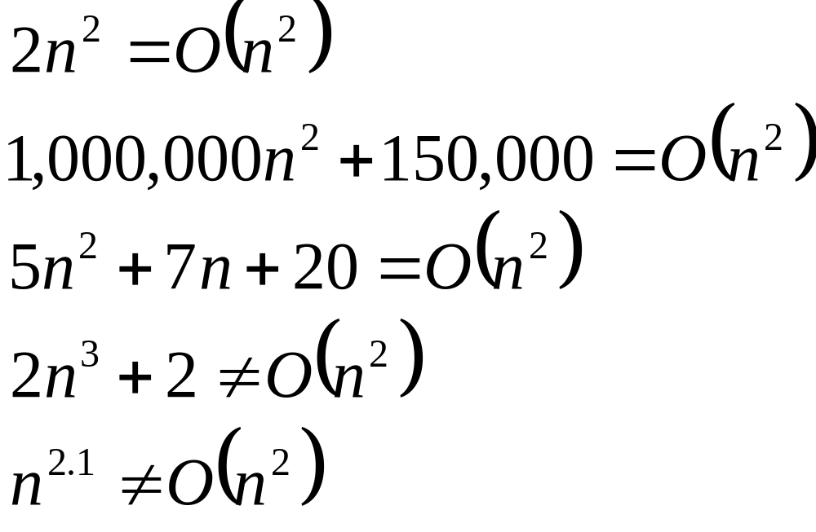
Big-O
Algorithm Analysis

Slide 19
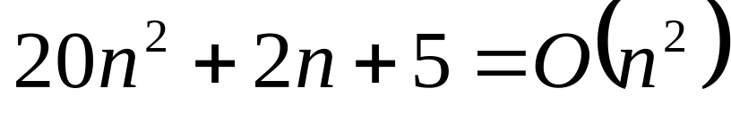
More Big-O
Prove that:
Let c = 21 and n₀ = 4
21n² > 20n² + 2n + 5 for all n > 4
n² > 2n + 5 for all n > 4
TRUE
Algorithm Analysis

Slide 20
Tight bounds
We generally want the tightest bound we can find.
While it is true that n² + 7n is in O(n³), it is more interesting to say that it is in O(n²)
Algorithm Analysis

Slide 21

Big Omega – Notation
Ω() – A lower bound
  n² = Ω(n)
  Let c = 1, n₀ = 2
  For all n ≥ 2, n² > 1 × n
Algorithm Analysis

Slide 22
Visualization of Ω(g(n))
f(n)
cg(n)
n₀
Algorithm Analysis

Slide 23
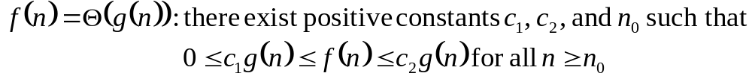
Θ-notation
Big-O is not a tight upper bound. In other words n = O(n²)
Θ provides a tight bound
In other words,
Algorithm Analysis

Slide 24
Visualization of Θ(g(n))
c₂g(n)
f(n)
c₁g(n)
n₀
Algorithm Analysis

Slide 25
A Few More Examples
n = O(n²) ≠ Θ(n²)
200n² = O(n²) = Θ(n²)
n^{2.5} ≠ O(n²) ≠ Θ(n²)
Algorithm Analysis

Slide 26
Some Other Asymptotic Functions
Little o – A non-tight asymptotic upper bound
  n = o(n²), n = O(n²)
  3n² ≠ o(n²), 3n² = O(n²)
Ω() – A lower bound
  Similar definition to Big-O
  n² = Ω(n)
ω() – A non-tight asymptotic lower bound
f(n) = Θ(n) ⇔ f(n) = O(n) and f(n) = Ω(n)
Algorithm Analysis

Slide 27
Visualization of Asymptotic Growth
ω(f(n))
Ω(f(n))
Θ(f(n))
f(n)
O(f(n))
o(f(n))
n₀
Algorithm Analysis

Slide 28
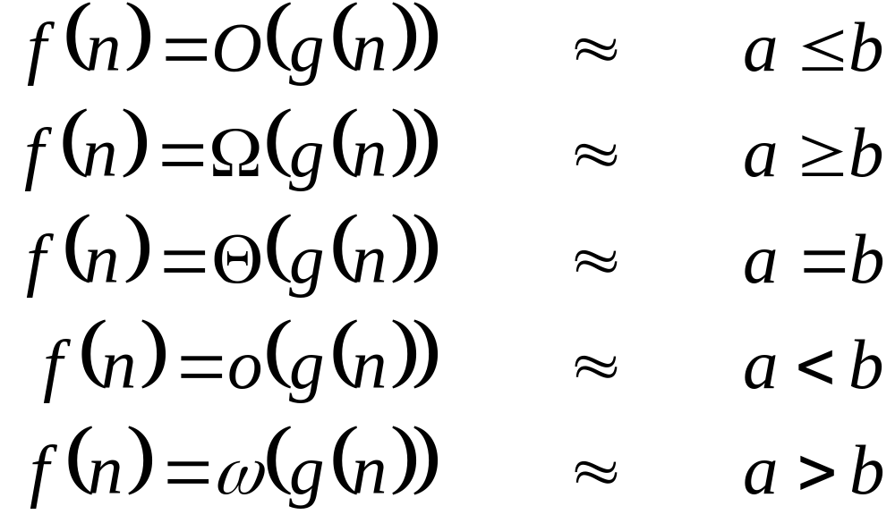
Analogy to Arithmetic Operators
Algorithm Analysis

Slide 29
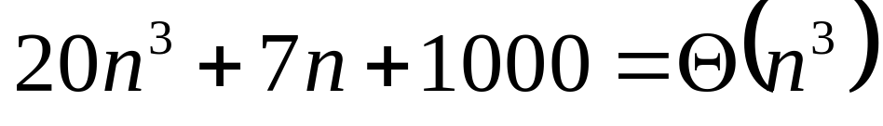
Example 2
Prove that:
Let c = 21 and n₀ = 10
21n³ > 20n³ + 7n + 1000 for all n > 10
n³ > 7n + 5 for all n > 10
TRUE, but we also need…
Let c = 20 and n₀ = 1
20n³ < 20n³ + 7n + 1000 for all n ≥ 1
TRUE
Algorithm Analysis

Slide 30
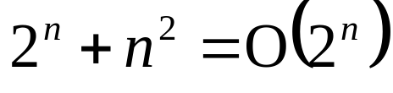
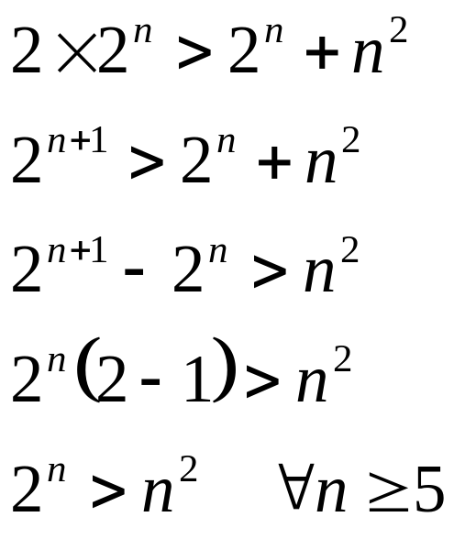
Example 3
Show that
Let c = 2 and n₀ = 5
✓
Algorithm Analysis

Slide 31
Looking at Algorithms
Asymptotic notation gives us a language to talk about the run time of algorithms.
Not for just one case, but how an algorithm performs as the size of the input, n, grows.
Tools:
  Series sums
  Recurrence relations
Algorithm Analysis

Slide 32
Others
For more help in solving series sums, see:
  Section 2.5, pages 30 – 34
  Section 14.1, pages 452 – 454
Algorithm Analysis

Slide 33
Best, Worst, Average Cases
Not all inputs of a given size take the same time to run.
Sequential search for K in an array of n integers:
  Begin at first element in array and look at each element in turn until K is found
Best case:
Worst case:
Average case:
Algorithm Analysis
Notes:
Best: Find at first position. Cost is 1 compare.
Worst: Find at last position. Cost is n compares.
Average: (n+1)/2 compares IF we assume the element with value K is equally likely to be in any position in the array.

Slide 34
Space Bounds
Space bounds can also be analyzed with asymptotic complexity analysis.
Time: Algorithm
Space Data Structure
Algorithm Analysis

Slide 35
Space/Time Tradeoff Principle
One can often reduce time if one is willing to sacrifice space, or vice versa.
  Encoding or packing information
    Boolean flags
  Table lookup
    Factorials
Disk-based Space/Time Tradeoff Principle: The smaller you make the disk storage requirements, the faster your program will run.
Algorithm Analysis

Slide 36
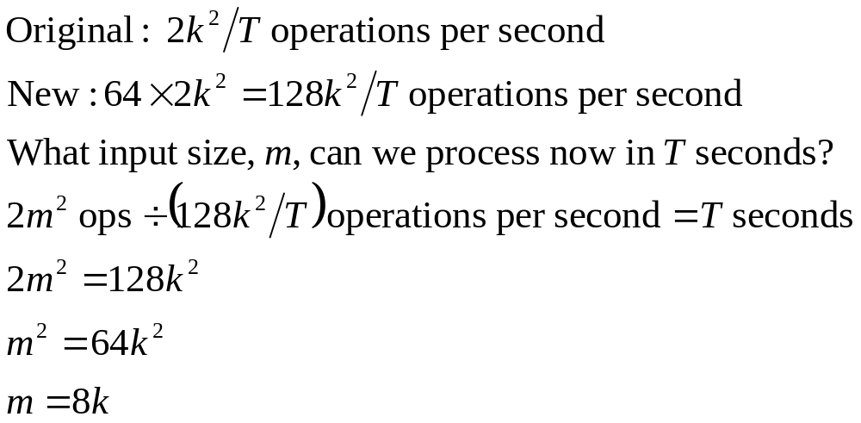
Faster Computer or Faster Algorithm?
Suppose, for your algorithm, f(n) = 2n²
In T seconds, you can process k inputs
If you get a computer 64 times faster, how many inputs can you process in T seconds?
Algorithm Analysis

Slide 37
Faster Computer or Algorithm?
If we have a computer that does 10,000 operations per second, what happens when we buy a computer 10 times faster?
T(n) | n | n’ | Change | n’/n
10n | 1,000 | 10,000 | n’ = 10n | 10
20n | 500 | 5,000 | n’ = 10n | 10
5n log n | 250 | 1,842 | √10 n < n’ < 10n | 7.37
2n² | 70 | 223 | n’ = √10n | 3.16
2^{n} | 13 | 16 | n’ = n + 3 | -----
Algorithm Analysis
Notes:
How much speedup? 10 times. More important: How much increase in problem size for same time expended? That depends on the growth rate.
n: Size of input that can be processed in one hour (10,000 steps).
n’: Size of input that can be processed in one our on the new machine (100,000 steps).
Note: for 2^{n}, if n = 1000, then n’ would be 1003.

Slide 38
Binary Search
// Return position of element in sorted
// array of size n with value K.
int binary(int array[], int n, int K) {
int l = -1;
int r = n; // l, r are beyond array bounds
while (l+1 != r) { // Stop when l, r meet
int i = (l+r)/2; // Check middle
if (K < array[i]) r = i; // Left half
if (K == array[i]) return i; // Found it
if (K > array[i]) l = i; // Right half
}
return n; // Search value not in array
}
Algorithm Analysis
Notes:
T(n) = T(n/2) + 1
T(1) = 1

Slide 39
Recurrence Relations
Recursion trees
Algorithm Analysis

